Slide 1
Distributed Energy Resource & Aggregation Participation Model & Data Standardization
Arjun Malhotra
DISTRIBUTED RESOURCES OPERATIONS
May 29, 2025

Slide 2
Overview of the DER & Aggregation
Participation Model

Slide 3
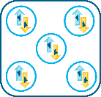
What is an Aggregator?
The entity that registers as a NYISO Customer
Responsible for enrollment of Aggregations, Distributed Energy Resource (DER) enrollment, bidding, scheduling, submitting meter data and settlements corresponding to participation in NYISO markets
May enroll more than one Aggregation
NYISO
Aggregator
Aggregation

Slide 4
DER & Aggregation Participation Model
The NYISO’s DER & Aggregation participation model allows Market Participants to group individual DER to form a single entity called an Aggregation that can participate in NYISO markets and services
Qualifying for wholesale market participation requires that Aggregations:
Satisfy all enrollment requirements as per tariff rules
Satisfy all interconnection requirements
Meet injection and withdrawal rate of at least 0.1 MW for a period of at least one hour
Must be capable of responding in real-time to NYISO dispatch instructions
Satisfy all data modeling and metering requirements
If elected, meet qualifications required for Installed Capacity Market participation

Slide 5
What is an Aggregation?
An Aggregation is a Resource that could be comprised of:
Two or more individual DER (Generating Resource or Demand Side Resource)
or
One or more individual Demand Side Resources
at separate Points of Interconnection and that are grouped and dispatched as a single unit by the ISO
An Aggregation may be comprised of DER interconnected to either the Transmission System or a distribution system in the NYCA
An Aggregation may include a mix of DER interconnected on the Transmission and distribution systems, but all DER must electrically map to the same Transmission Node

Slide 6
Aggregations - Size Requirement
The minimum size requirement for providing Energy, Operating Reserve, and Installed Capacity is 100 kW. The minimum size requirement to supply Regulation is 200 kW.
If an Aggregation offers a combination of Energy injections, Energy withdrawals, and/or Demand Reductions, the Aggregation must offer the minimum offer level of 100 kW for each response type.
There is no maximum size limitation for an Aggregation

Slide 7
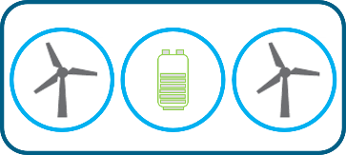
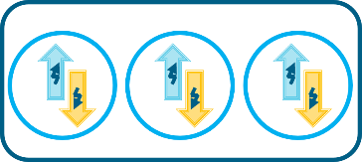
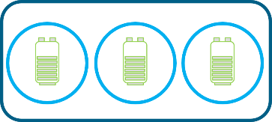
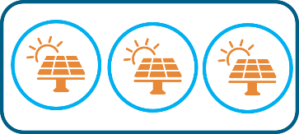
Aggregations Types
Individual DER will participate in an Aggregation under the market rules for either:
A DER Aggregation (multiple Resource types in the Aggregation OR Demand Response)
Example 1: An Aggregation with two Intermittent Power Resources (IPR) and one Energy Storage Resource (ESR) electrically located to the same Transmission Node
Example 2: An Aggregation consisting of three Demand Resources
The specific Resource type (when there is a Single Resource Type (SRT) in the Aggregation)
Example 1: An Aggregation of ESRs
Example 2: An Aggregation of Solar IPRs
DER Aggregations
SRT Aggregations

Slide 8
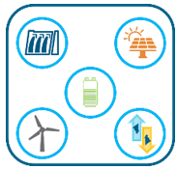
What is a DER?
DER:
(i) a facility comprising two or more different technology types located behind a single Point of Interconnection (POI) with a maximum Injection Limit of 20 MW,
(ii) a Demand Side Resource, or
(iii) a Generator with a maximum Injection Limit of 20 MW.
A DER can be:
A single facility at a distinct physical location (street address), utility account number, revenue grade meter and Point of Interconnection (POI) to the Distribution system, or
More than one facility at a single physical location, each with their own
Revenue grade meter, as per requirements
Separate utility account numbers and/or Points of Interconnection (POI), and
Operated independently from other facilities at that physical location
POI (1)
POI (2)
POI (3)
RM
RM 1
RM 2
Facility 1
Facility 2
Facility 3
Physical Location 1
Physical Location 2

Slide 9
DER - Assets
Assets are defined as different technologies located behind a single Point of Interconnection (POI), associated with a single utility account and net meter
‘Technology types’ refers to any of the following categories of an ‘asset’
Demand Side Resource
Generator
Energy Storage Resource
Solar
Wind, or
Landfill Gas
Examples of Assets within a DER facility
POI
POI
POI
DER
DER
DER
Asset: DR Resource
Asset 1: wind
Asset 2: ESR
Asset 1: ESR
Asset 2: CC gen

Slide 10
DER - Assets
Each DER must have a 10-kW minimum capability which is applied to Demand Reduction, Injection, and Withdrawal capabilities separately, pursuant to Services Tariff Sections 4.1.10 and 2.5
Therefore, an individual DER with a combination of assets capable of Demand Reduction, Injection, and Withdrawal shall have the 10-kW minimum capability applied to each of the three response types
A DER could comprise one or more assets
There is no limit on the number of assets comprising an individual DER
A DER can only contain one Demand Reduction asset (as there can only be one load associated with a DER )
An asset may be a singular generation source (e.g., one wind turbine) or may reflect a composite of several of the same generation sources behind the same meter (e.g., ten identical wind turbines)

Slide 11
Summary: Granularity of an Aggregation
Transmission Node
Aggregation
POI (A)
POI (B)
DER A
DER B
Asset 1
Asset 2
Asset

Slide 12
DER Data Standardization

Slide 13
Overview of Enrollment Process
Starts first of the month prior to participation month
Data Standardization
NYISO Customer
Registration
Submission of DER/Aggregation enrollment
Initial NYISO Validation
Distribution Utility Review
NYISO Review
Market Participation (begins first day of calendar month)
Aggregator
Registration
Up to 60 days
Approximately
60 days
Calendar month leading up to first day of participation
Note: Timelines on this slide are an estimate

Slide 14
Data Standardization
Aggregation Enrollment Import File Aggregation type, Meter Authority
DER Enrollment Import File TOA#, Meter ID Number, Asset Source ID

Slide 15
Useful Links
Aggregation System User Guide
Aggregation Manual
ICAP Manual
Online Learning – NYISO
NYISO Services Tariff

Slide 16
Our Mission and Vision
Mission Ensure power system reliability and competitive markets for New York in a clean energy future
Vision Working together with stakeholders to build the cleanest, most reliable electric system in the nation

Slide 17
Questions?

