Slide 1
Identity for Everything
Cyber Security for Extreme EV Fast Charging Infrastructure (NIST NCCOE debrief)

Slide 2

U.S. EV Market overview
There are approximately 2M electric vehicles (EV) in operation
The number of EV is projected to be 24.6M by 2030
The EV infrastructure was prominently integrated into the Infrastructure Investment and Jobs Act and is also expected to grow.
As of 2023, there were over 48,000 public charging stations in the US, and a commitment by the Infrastructure Investment and Jobs Act is in place to increase this number to 500,000 by 2030.
The U.S. EV charging infrastructure market size was valued at $3.15B in 2022 and is expected to grow to $24B by 2030.
Notes:
Currently, there are approximately 2M electric vehicles (EV) in operation, and the number of EV is projected to be 24.6M by 2030 [EEI-2022]. The EV infrastructure was prominently integrated into the Infrastructure Investment and Jobs Act and is also expected to grow. As of 2023, there were over 48,000 public charging stations in the US, and a commitment by the Infrastructure Investment and Jobs Act is in place to increase this number to 500,000 by 2030. The U.S. EV charging infrastructure market size was valued at $3.15B in 2022 and is expected to grow to $24B by 2030

Slide 3
Overview
Given the current value, expected growth, potential for cyber related attacks, and the criticality of the transportation and energy sectors, the Department of Energy (DOE) in collaboration with the Electric Power Research Institute (EPRI) studied the Electric Vehicle/Extreme Fast Charging ecosystem (EV/XFC ecosystem).
Recognizing the need for relevant parties to assess their cybersecurity posture as a part of risk management, the DOE commissioned NIST to apply the Cyber Security Framework (CSF) to the EV/XFC ecosystem.
Now Available — Final NIST IR 8473, Cybersecurity Framework Profile for Electric Vehicle Extreme Fast Charging Infrastructure
https://nvlpubs.nist.gov/nistpubs/ir/2023/NIST.IR.8473.pdf
Notes:
Given the current value, expected growth, potential for cyber related attacks, and the criticality of the transportation and energy sectors, the Department of Energy (DOE) in collaboration with the Electric Power Research Institute (EPRI) studied the Electric Vehicle/Extreme Fast Charging ecosystem (EV/XFC ecosystem). Recognizing the need for relevant parties to assess their cybersecurity posture as a part of risk management, the DOE commissioned NIST to apply the Cyber Security Framework (CSF) to the EV/XFC ecosystem

Slide 4
EV/XFC ecosystem
The EV/XFC ecosystem relies on multiple connected domains
Electric Vehicles (EV)
Electric Vehicle Supply Equipment (EVSE)
electrical conductors, related equipment such as Battery Energy Storage Systems (BESS), software, and communications protocols that deliver energy efficiently and safely to the vehicle.
Cloud/Third-Party Organization
consists of independently owned and operated domains, and most charging stations are operated by a charging network with business models that blend station, electricity, and vehicle charging sales together. Third parties are individuals or entities that facilitate transactions but are not one of the primary parties within the exchange. The EV/XFC ecosystem typically uses cloud service providers for these transactions because they are suitable for sensitive data exchanges that involve financial information, personally identifiable information, and other potentially sensitive data.
Utilities/Building Systems
Utilities provide the power necessary to fuel the EV/XFC 280 ecosystem. Building and facility management systems may be present in installations where energy management is required, such as EVSE installed at shopping centers, as well as where distributed energy resources (DER) may be present or where physical security control is required.

Slide 5
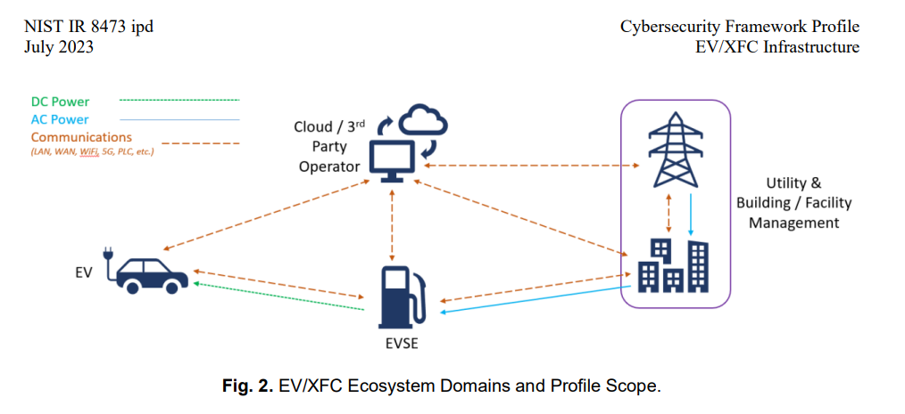
EV/XFC ecosystem

Slide 6
Objectives
Deliver Reliable Performance through Secure Communications
Maintain Resilience of the XFC Infrastructure
Build and Maintain Trustworthy Relationships with Partners and Customers
Maintain Continuity of Operations

Slide 7
Objective 2: Maintain Resilience of the XFC Infrastructure
All users in the EV/XFC ecosystem should have reliable access to services. A loss of cybersecurity may impact physical security; therefore, organizations must implement safeguards to ensure the resilience of the EV/XFC ecosystem.
EV. EV owners want assurance that their vehicle is protected before they are willing to participate in the charging ecosystem. Batteries are a significant expense, and a compromised XFC ecosystem could potentially lead to physical damage to the battery. Thus, implemented safeguards will ease the minds of users and encourage them to use the charging stations.
XFC/EVSE. Due to the unique position of charging stations in the ecosystem, its geographical dispersion, and its general lack of physical security, charging stations have become an appealing target for threat actors. EVSE infrastructures should be protected, both cyber and physical, to prevent attacks like ransomware or damage to the charging infrastructure itself.
Cloud/Third-Party. The cloud/third-party environment facilitates connectivity between domains of the infrastructure. It should be protected to maintain operations.
Utility/Building Management Systems. Utilities should have protection systems in place to prevent manipulation of utility components to maintain safe operations.

Slide 8
Objective 1: Deliver Reliable Performance through Secure Communications
Communicating across the XFC infrastructure is critical to the performance in the EV/XFC ecosystem and the success of the EV industry. Because of this in tandem dependency, the communications should be reliable and secure to fulfill the ecosystem’s mission needs
EV. Communication between the EV (battery management system) and the charging station is necessary to facilitate the EV battery charging process. The EV connects to cloud/third-party applications to manage the transactions and collect data. EV user systems (e.g., infotainment) also may communicate with other vehicle systems, such as the charge controller and battery management systems. The interface between these applications presents a potential attack surface for malicious actors to cause damage.
XFC/EVSE. The charging station requires secure communication to the cloud to facilitate financial transactions, provide authorization to charge, collect maintenance logs, and receive updates. Additionally, the charging station draws power from the metered utility.
Cloud/Third-Party. Cloud service providers require reliable secure connections to the EV, charging station, and the utility to facilitate the charging process. Secure reliable communications allow for validation of financial transactions, protect personal information, and allow for maintenance updates and logs to be transmitted quickly and economically.
Utility/Building Management Systems. Utilities provide power to the charging station. Coordination between the XFC chargers and utilities are required for various smart grid applications such as peak shaving/load shifting or forecasting. Where this communication exists, it must be reliable and secure

Slide 9
Objective 3: Build and Maintain Trustworthy Relationships with Partners and Customers
EV/XFC cybersecurity requires collection and use of partner and customer data from many sources.
Building and maintaining relationships with relevant parties demands organizations consider and mitigate against risks throughout the information lifecycle.
Protecting the confidentiality of sensitive information (e.g., system status information) ensures confidence in the organization and establishes trust among partners and with customers.
Personal information should also be protected (e.g., credit card information, individual XFC usage patterns) to ensure that user information is not correlated for inappropriate use, resulting in a loss of trust from users.
Cybersecurity disruptions to systems can impact product quality, leading partners, and customers to question the trustworthiness of the organization

Slide 10
Objective 4: Maintain Continuity of Operations
The EV/XFC ecosystem must sustain operations and ensure the organization’s mission continues in the face of adversity.
Organizations need to monitor for deviations to identify potential cybersecurity events and detect and respond to anomalous behavior.
Cyber supply chain risk management processes should also be identified and agreed to by organizational relevant parties.
Moreover, organizations account for disruptions through business continuity/contingency planning and implementation of response and recovery plans.

Slide 11
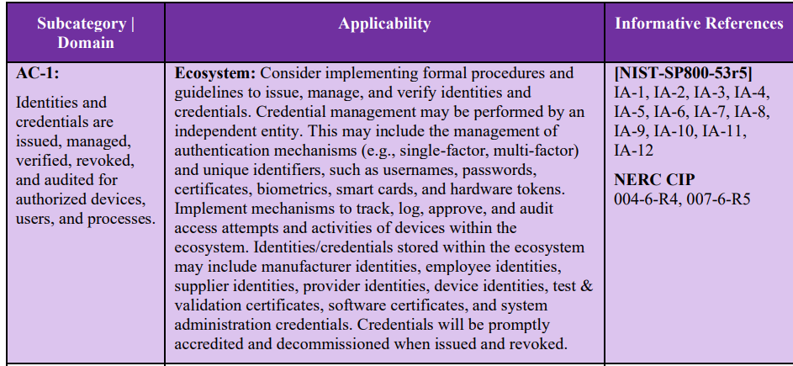
NIST CyberSecurity Framework - Identity Management, Authentication and Access Control
Notes:
NIST Cybersecurity Framework
Cybersecurity Framework v1.1
PR: Protect
PR.AC: Identity Management, Authentication and Access Control
Description
Access to physical and logical assets and associated facilities is limited to authorized users, processes, and devices, and is managed consistent with the assessed risk of unauthorized access to authorized activities and transactions.
Framework Subcategories
PR.AC-1: Identities and credentials are issued, managed, verified, revoked, and audited for authorized devices, users and processes
[csf.tools Note: Subcategories do not have detailed descriptions.]
Credential life cycle management

Slide 12
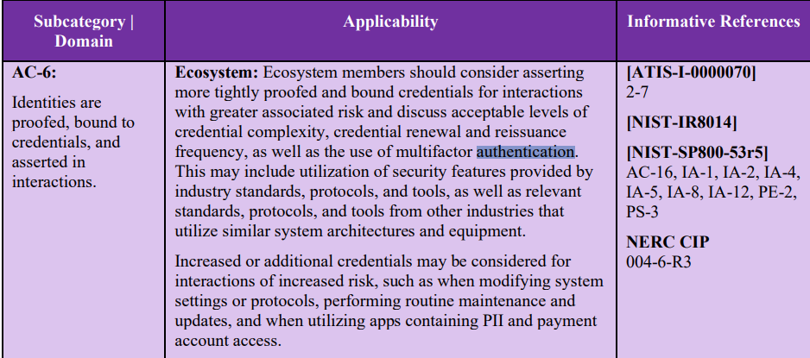
NIST CyberSecurity Framework - Identity Management, Authentication and Access Control
Notes:
Identity proofing

Slide 13
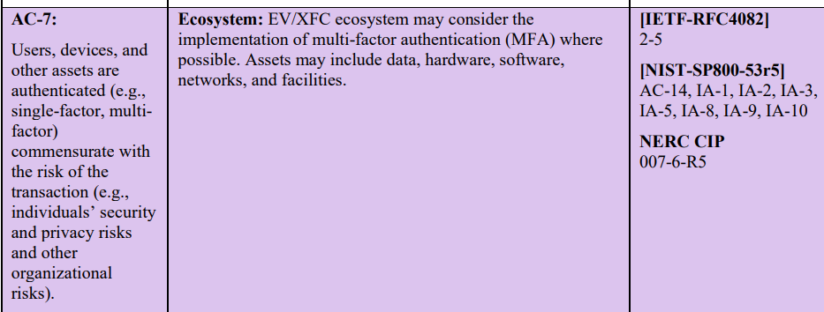
NIST CyberSecurity Framework - Identity Management, Authentication and Access Control
Notes:
Authentication

Slide 14
Summary
NCCOE Cyber Security Framework for EV/XFC sites the need for
User, device, machine credential life cycle management
Identity proofing
Access control via authenticated devices
WEQ-012 address the above three requirements

