Slide 1
Common Grid Service Terms Motivation for NAESB Standards Request R22001 NAESB WEQ-BPS Meeting Presentation 4 August 2022
Reliable
Resilient
Secure
DOE Grid Modernization Laboratory Consortium (GMLC)
Grid Modern-
ization
Rich Brown, Principal Investigator
Lawrence Berkeley National Laboratory
Steve Widergren, co-PI
Pacific Northwest National Laboratory
Sustain-
able
Affordable
Flexible

Slide 2
Topics
Review desired outcome
Work plan
Common grid service types
WEQ-000 mapping and comparison
Energy schedule service
Description
Attributes
Additional information: measurement, example operational objectives, origin of service
Correspondence with existing service definitions: CAISO, SPP, PJM
Reserve service
Description
Attributes
Additional information: measurement, example operational objectives, origin of service
Correspondence with existing service definitions: CAISO, SPP, PJM
Next meeting: 23 Aug 2022, 1-4pm Central
Homework: participants choose an existing energy schedule service definition and describe in common service form

Slide 3
Desired Outcome of Effort
Classification of a (small) set of grid services
Common names for these grid-service types
Clear definitions of the service types
Parameterized performance expectations (i.e., electrical attributes, timing attributes)
Accommodate necessary specialization
Effort does NOT,
Propose a uniform market policy on services
Prescribe a solution for DER integration into wholesale electric markets
Specify DER management technology or platforms

Slide 4
Format of Work Product
WEQ-000
Grid service name: 1- or 2-word title of the service
Description: short (1- or 2-sentence) definition of the service
WEQ-xxx
Performance expectation: parameters that describe the expected performance delivered
Electrical attributes:
Electricity-related quantities or qualities (e.g., power, energy, voltage level) over the performance period.
Electrical location: the physical location where the service is delivered in the electric system.
Timing attributes:
Delivery schedule: period over which the grid service is expected to take place.
Delivery schedule notification: timing associated with notification that the delivery schedule for a service is established.
Response time: Response time is the allowed elapsed time between the moment when the grid service is to start and the moment when the desired behavior meets the defined threshold for a given grid service.
Additional information
Performance measurement examples: typical ways the service is measured for verification
Example service requestor operational objectives: applications for calling the service
Origin of service definition: context or background on why the service exists
Notes:
WEQ-000: NAESB glossary

Slide 5
Work Plan
Completed:
Scope of effort
Review state of grid services
Aug 4:
Identify common grid service types
Draft the common grid services descriptions for
Energy schedule service
Reserves service
Aug 23:
Draft common grid services descriptions for
Regulation service
Frequency response service
Voltage management service
Emergency service
Sep 7:
Reconcile WEQ-000 standard terminology
Map existing grid services to common services
Sep 27:
Prepare draft material of common grid services for industry informal comment
Continue mapping of existing grid services
Oct ???
Address industry informal draft comments (if any)
WEQ Executive Committee meeting 18 Oct
Refine draft standard consensus recommendation
Oct/Nov ???
Review refinements to draft standard
Vote recommendation out of committee

Slide 6
Reference Common Grid Services
Energy Schedule Service: A service in which a resource is scheduled to produce or consume energy from an electrical Service Location over a specified scheduled period.
Reserve Service: A service in which a resource commits availability to produce or consume power based upon instructions by the System Operator to meet reserve capacity requirements that are established to meet applicable reliability standards. Reserved assets would be engaged as needed during this period.
Regulation Service: A service in which a resource provides an increase or decrease in real power production or consumption from an electrical Service Location over a specified scheduled period against a predefined real-power base point following a System Operator’s signal. The signal interval is one to several seconds and the associated performance period is of a significantly shorter duration than the typical energy scheduling service performance period.
Frequency Response Service: A service that uses “the response of resources and load to arrest local changes in frequency” (NERC 2021).
Voltage Management Service: A service in which a resource can provide voltage support (raise or lower) within a specified upper and lower voltage range at an electrical location over a specified scheduled period.
Emergency Service: A service that uses the capability of provider resources to energize without an outside electrical supply or quickly change energization levels during an electric grid emergency.
See Gap Analysis workpaper for comparison to existing WEQ-000 terms

Slide 7
Energy Schedule Service
Subcommittee Proposal: consider changing to Energy Service; will need to reconcile with WEQ-000

Slide 8
Energy Service
Energy Service: A service in which a resource is scheduled to produce or consume energy from an electrical Service Location over a specified scheduled period.
Performance Expectation
Electrical Attributes:
Power: the power level of the resource for production or consumption over the performance period.
Energy: the quantity of electric energy for production or consumption over the performance period. The agreement can specify the price for a quantity of energy at different power levels (a curve).
Service Location: a NAESB defined term matching this definition: “The physical location at which connection to the transmission or distribution system is made.”
Timing Attributes:
Delivery schedule: the period of performance describes the start time and end time of the scheduled energy production or consumption. This can also be specified with a start time and a duration.
Delivery schedule notification: The timing associated with notification that the delivery schedule for the energy service is established. For example, the results of a market process are published by specified times and notify the participants of their scheduled delivery of the service.

Slide 9
Energy Schedule Service (cont.)
Additional information
Performance Measurement: The applicable Governing Documents specify how performance is measured. This is usually done with revenue grade meters that measure energy in intervals synchronized to the delivery schedule for the service. Periodic power measurements are also used.
Operational Objective Examples: system peak load management, balance energy use with production, manage delivery limitations caused by electric flow constraints.
Origin of Service Definition: Wholesale markets arrange for scheduled blocks of energy to match anticipated load. These are done in many forms including bilateral agreements between energy suppliers and energy users. They are also done in centrally-managed markets, such as run by independent market operators. In the wholesale situation the price and quantity of energy delivery over the performance period is negotiated ahead of time with information provided to an independent system operator for ensuring reliable system operation. The agreements also stipulate the penalties or fees for non-performance (over or under production and consumption). Most ISO/RTOs have real-time (5-minute to one hour) and day-ahead (next operating day) markets at the wholesale level. Some may also have real-time and day-ahead demand response energy scheduling programs with programs for retail customers to be able to respond to wholesale electricity prices. Participants are compensated based on the amount of reduction made during the delivery schedule interval.

Slide 10
Energy Schedule Service Mapping Example
Summary on next slide
Further details in meeting whitepaper
CAISO
SPP
PJM

Slide 11
Grid Entity/Service | Electrical Attributes |  |  | Timing Attributes
Service | Power | Energy | Service Location | Delivery Schedule | Delivery schedule notification
CAISO Day-Ahead Scheduled Energy | Bid curves consist of MW, $/MWhr quantities | Amount of energy produced or consumed in each hourly interval in MWh | “producing node” and “delivering nodes.” | each 24-hour period of the upcoming trading (i.e., operating) day. | published at 1pm prior to the start of the trading day
CAISO Hourly Real-Time Scheduled Energy | Bid curves consist of MW, $/MWhr quantities | Amount of energy produced or consumed in each dispatch interval in MWh | “producing node” and “delivering nodes.” | or the upcoming trading (i.e., operating) hour | published ~45 minutes prior
SPP Day-Ahead Market for Energy | Bid curves consist of MW, $/MWhr quantities | Amount of energy produced or consumed in each dispatch interval in MWh | Electrical nodes (ENodes) represent the physical connection points | 24-hour period of the upcoming operating day | published at 1pm prior to the start of the operating day
SPP Real-Time Balancing Market for Energy | Bid curves consist of MW, $/MWhr quantities | Amount of energy produced or consumed in each of the real-time dispatch (i.e., schedule) intervals in MWh | Electrical nodes (ENodes) represent the physical connection points | every 5-minute operating interval in the operating hour | not published, 5-minute dispatch decisions
PJM Day-Ahead Energy | Bid curves consist of MW, $/MWhr quantities | Amount of energy produced or consumed in each dispatch interval in MWh | pricing nodes (pnode) where Locational Marginal Price is calculated | each hour of the 24-hour period of the upcoming (i.e., operating) day | published at 1:30pm with a brief rebidding period, results are posted at 2:15pm prior to the start of the operating day
PJM Real-Time Energy | Bid curves consist of MW, $/MWhr quantities | amount of energy produced or consumed in each of the real-time dispatch (i.e., schedule) intervals in MWh. | pricing nodes (pnode) where Locational Marginal Price is calculated | Submitted 65 minutes prior for operating hour in 5-minute intervals | not published, 5-minute dispatch decisions

Slide 12
Reserve Service

Slide 13
Reserve Service
Reserve service: A service in which a resource commits availability to produce or consume power based upon instructions by the System Operator to meet reserve capacity requirements that are established to meet applicable reliability standards. Reserved assets would be engaged as needed during this period.
Performance Expectation
Electrical Attributes:
Power: the power level of the resource for production or consumption over the performance period.
Energy: the quantity of available electric energy held in reserve which could be called upon for production or consumption. The agreement can specify the price for a quantity of energy at different power levels (a curve) that will be available to be called upon.
Service Location: a NAESB defined term matching this definition: “The physical location at which connection to the transmission or distribution system is made.”
Timing Attributes:
Delivery schedule: the period of performance describes the start time and end time of the reserve production or consumption. This can also be specified with a start time and a duration. The service agreement specifies the periodicity of the scheduling agreement (e.g., daily, hourly, 30-minute periods)
Delivery schedule notification: The timing associated with notification that the delivery schedule for the reserve service is established. For example, the results of a market process are published by specified times and notify the participants of their scheduled delivery of the service.
Speed of response: the quality of the resource to change its operating position over a time interval. This can be measured in amount of time to have the resource available (e.g., 30 minutes), the MW, a percent of reserved quantity per unit time, and/or agreed quantity over an interval.

Slide 14
Reserve Service (cont.)
Performance Measurement: The applicable Governing Documents specify how performance is measured. Energy interval metering may be combined with time stamped power measurements.
Operational Objective Examples: System Operators use the concept of reserves to address unplanned situations that can occur during real time system dispatch. These include contingency response from line or generation equipment outages or derations that cause deviations from planned operations. Environmental events may also deviate from planned production from solar or wind generating resources. These deviations may require fast-acting reserves (such as from synchronized generators) or slow response reserves (such as from non-synchronized generators that need several minutes to become available). Depending upon the operational situation, reserves may need to be available at different rates. For example, a weather forecast event may have one or more hours for reserves to respond, while a line or generator outage may require a more rapid response time.
Origin of Service Definition: Power system operators use spinning and non-spinning reserves to maintain reliable balance of supply and demand in the system. Wholesale markets negotiate scheduled blocks of energy reserves to support this need. These are done in ISO/RTO markets, such as those run by independent market operators. In the wholesale situation the price and quantity of power or energy available over the commitment period will be negotiated ahead of time with information provided to an independent system operator for ensuring reliable system operation. The agreements also stipulate the penalties or fees for non-performance. While wholesale markets set prices for operating the resources, the owners relinquish control of their resources to the system operator during the operating period. Demand side resources also participate in many wholesale markets and are used like contingency reserves. That is, aggregated demand response providers may be called upon for various operating situations. They usually have longer contract intervals and notification periods. They may have stipulations on the maximum number of times they are called in a year or season. Their process for determining performance and settlement is different than traditional generation reserve resources.

Slide 15
Reserve Service Mapping Examples
See examples in meeting whitepaper
CAISO
SPP
PJM

Slide 16
Next Meeting
4 Aug 2022: 1-4pm Central
Homework
Meeting participants map familiar existing energy schedule and reserve services into common grid services format

Slide 17
Extra Slides

Slide 18
Standards Request R22001
Objective:
Classify common grid services that accommodate the diverse grid needs in different regions
Define common grid service types for wholesale power system interactions
Derive commonalities and important variations found in existing grid services
Meet near to mid-future needs gathered from major US ISO/RTOs and utilities
Accommodate specialization: performance characteristics and expectations
Qualification, performance expectations, monitoring, reconciliation, and settlement vary by operational policy of each region
But defining common policy is beyond the scope of this proposal
Benefits:
Consistency: common service-type names, definitions, and performance characteristics eases participation across markets and regions
Differentiation: facilitates valuation of resources that provide unique electrical performance (e.g., ramping) or environmental attributes (clean power)
Extensibility: foundation for retail-level grid service interactions with flexible, grid-edge resources

Slide 19
Service-Oriented Principles
Operational objectives describe why a service is used
Use cases helpful for describing the desired performance characteristics from a service
Examples: schedule energy to meet peak load forecast, or reserve energy for outage contingency
Boundaries of responsibility are clearly understood between service requester and provider
Service definition says what is to be performed – not how
Example: generation needs to be at nominal power level 100 MW in 10 minutes and maintained for 1 hour
Any equipment type that meets the performance requirement can provide the service
Service provider understands what to do, where, and when – not why
The service requestor’s reasons for invoking the service (the operational objectives) are hidden
Example: a gas-turbine generator does not need to know it is scheduled for peak-load coverage
Benefits
Decouples areas of concern - makes integration simpler, cleaner, modular
Same service can be used to address multiple objectives
Accommodates service provider technology decisions within performance requirements

Slide 20
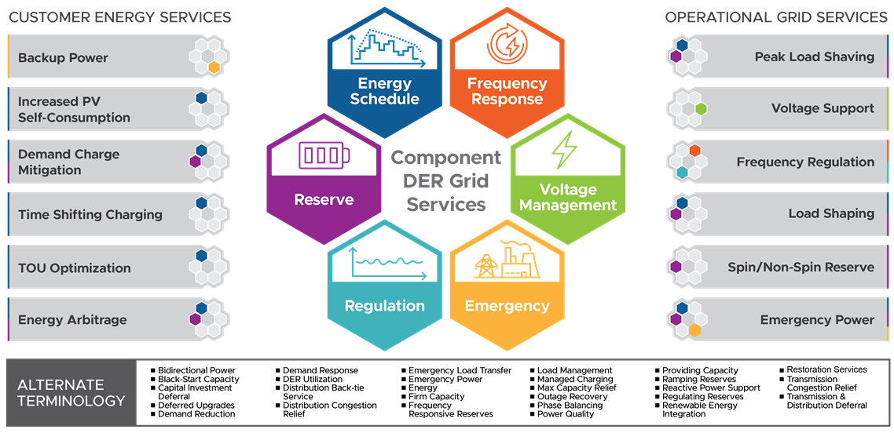
Example Grid Service Types
Provider Operational Objectives
Grid Operational Objectives
Courtesy of Chris Irwin (DOE) and Cortland Johnson (PNNL)

