Slide 1
Common Grid Service Terms Motivation for NAESB Standards Request R22001 NAESB WEQ-BPS Meeting Presentation 18 July 2022
Reliable
Resilient
Secure
DOE Grid Modernization Laboratory Consortium (GMLC)
Grid Modern-
ization
Rich Brown, Principal Investigator
Lawrence Berkeley National Laboratory
Steve Widergren, co-PI
Pacific Northwest National Laboratory
Sustain-
able
Affordable
Flexible

Slide 2
Topics
Level setting
Standards request R22001 – objectives
Service/performance-oriented principles
Example grid service types
State of transmission grid services
Example form of work product

Slide 3
Level Setting

Slide 4
Standards Request R22001
Objective:
Classify common grid services that accommodate the diverse grid needs in different regions
Define common grid service types for wholesale power system interactions
Derive commonalities and important variations found in existing grid services
Meet near to mid-future needs gathered from major US ISO/RTOs and utilities
Accommodate specialization: performance characteristics and expectations
Qualification, performance expectations, monitoring, reconciliation, and settlement vary by operational policy of each region
But defining common policy is beyond the scope of this proposal
Benefits:
Consistency: common service-type names, definitions, and performance characteristics eases participation across markets and regions
Differentiation: facilitates valuation of resources that provide unique electrical performance (e.g., ramping) or environmental attributes (clean power)
Extensibility: foundation for retail-level grid service interactions with flexible, grid-edge resources

Slide 5
Service-Oriented Principles
Operational objectives describe why a service is used
Use cases helpful for describing the desired performance characteristics from a service
Examples: schedule energy to meet peak load forecast, or reserve energy for outage contingency
Boundaries of responsibility are clearly understood between service requester and provider
Service definition says what is to be performed – not how
Example: generation needs to be at nominal power level 100 MW in 10 minutes and maintained for 1 hour
Any equipment type that meets the performance requirement can provide the service
Service provider understands what to do, where, and when – not why
The service requestor’s reasons for invoking the service (the operational objectives) are hidden
Example: a gas-turbine generator does not need to know it is scheduled for peak-load coverage
Benefits
Decouples areas of concern - makes integration simpler, cleaner, modular
Same service can be used to address multiple objectives
Accommodates service provider technology decisions within performance requirements

Slide 6
Desired Outcome of Effort
Classification of a (small) set of grid services
Common names for these grid-service types
Clear definitions of the service types
Parameterized performance expectations (i.e., electrical attributes, timing attributes)
Accommodate necessary specialization
Effort does NOT,
Propose a uniform market policy on services
Prescribe a solution for DER integration into wholesale electric markets
Specify DER management technology or platforms

Slide 7
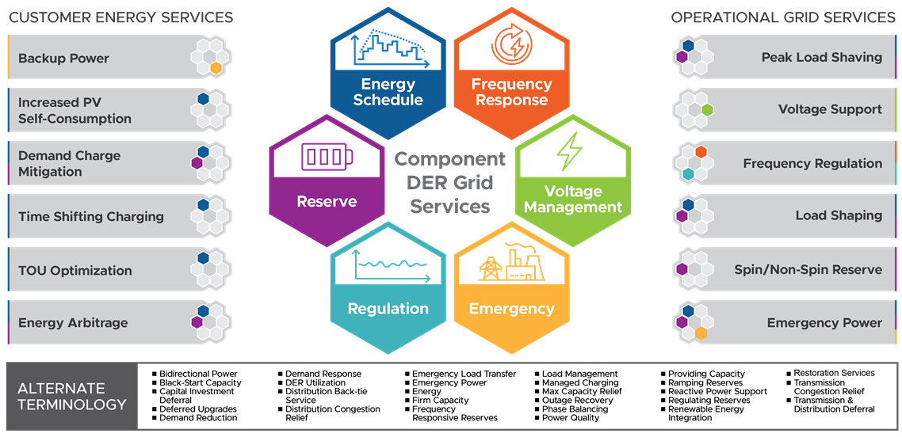
Example Grid Service Types
Provider Operational Objectives
Grid Operational Objectives
Courtesy of Chris Irwin (DOE) and Cortland Johnson (PNNL)

Slide 8
State of Transmission Grid Services

Slide 9
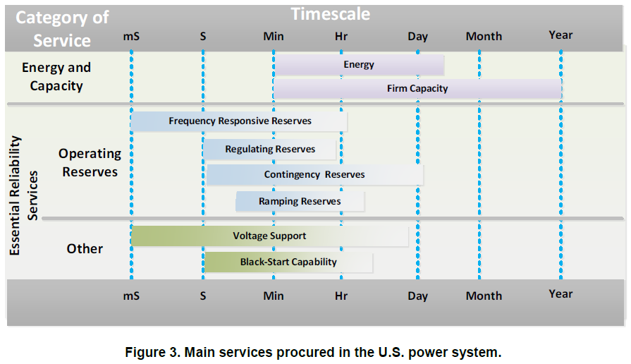
State of Grid Services – Workpaper
Background and purpose
Sponsored by DOE Grid Modernization Lab Consortium
Overall project is developing a simplified, service-oriented interface to coordinate DERs and the grid
This paper reviews current state of grid service definitions to help standardize interactions with the electricity grid more broadly
Summarized literature for transmission grid service categories
National labs, FERC, NERC,
Existing ISO/RTO products, European sources
Also reviewed distribution grid services (not presented here)
Found that many grid services differ in their details, but can generally be grouped into about six general categories
Source: Denholm et al., 2019

Slide 10
Defining Services Based on Performance
Operational Objective
Fundamental underlying physical needs, stated as objectives, of the grid for safe, reliable, robust, and economically efficient operation
Often in form of balancing supply and demand at various time scales and for various purposes
Examples: Real-time energy, spinning reserve, ramping
Performance Expectation
Describes a generator’s or consumer’s expected physical performance in delivering power to or consuming power from the grid
Can be clearly defined and measured
Describes what is needed, but not why

Slide 11
Correlating Service Categories to Existing Terms
Grid service categories |  | FERC 888 (1996) | NERC IOS (2002) | NERC ERS (2014) | CAISO | PJM
Energy service |  | Scheduling, System Control and Dispatch |  |  | Day-Ahead & Real-Time energy | Energy
Capacity service |  |  |  |  | (no capacity market) | Reliability Pricing Model Capacity Performance
ERS | Frequency Response | Regulation and Frequency Response | Frequency Response | Inertia; Frequency Disturbance Performance; Frequency Control
 | Regulation |  | Regulation | Regulation | Regulation Up; Regulation Down | Regulation (Traditional and Dynamic)
 | Contingency Reserve | Operating Reserve - Spinning Reserve and Supplemental Reserve | Contingency Reserve | Contingency Reserves (spinning, non‐spinning and supplemental) | Spinning Reserve; Non-Spinning Reserve | Synchronized Reserve; Non-Synchronized Reserve; Secondary Reserve
 | Load Following (Ramping Reserve) | Energy Imbalance | Load Following | Load Following; Ramping Capability | Flexible Ramping (in Real-time Market)
 | Reactive Power Supply from Gen. Sources | Reactive Supply and Voltage Control from Generation Sources | Reactive Power Supply from Generation Sources | Reactive Power/PF Control; Voltage Control; Voltage Disturb. Perf. | Voltage Support | Voltage Control
 | System Blackstart Capability |  | System Blackstart Capability |  |  | Black Start Service

Slide 12
Example Form of Work Product

Slide 13
Example Form of Work Product
WEQ-000
Grid service name: 1- or 2-word title of the service
Description: short (1- or 2-sentence) definition of the service
WEQ-xxx
Performance expectation: parameters that describe the expected performance delivered
Electrical attributes:
Electricity-related quantities or qualities (e.g., power, energy, voltage level) over the performance period.
Electrical location: the physical location where the service is delivered in the electric system.
Timing attributes:
Delivery schedule: period over which the grid service is expected to take place.
Delivery schedule notification: timing associated with notification that the delivery schedule for a service is established.
Response time: Response time is the allowed elapsed time between the moment when the grid service is to start and the moment when the desired behavior meets the defined threshold for a given grid service.
Additional information
Performance measurement examples: typical ways the service is measured for verification
Example service requestor operational objectives: applications for calling the service
Origin of service definition: context or background on why the service exists
Notes:
WEQ-000: NAESB glossary

Slide 14
Example – Energy Schedule Service
WEQ-000
Energy Schedule Service: The energy schedule service requests a planned import or export of energy from an electric service location over a specified scheduled period.
WEQ-xxx
Performance Expectation
Electrical Attributes:
Power: a specification of the power level of the resource for import or export over the performance period.
Energy: a specification of the quantity of electric energy for import or export over the performance period. The agreement can specify a fixed quantity of energy with the price paid for that quantity, or it may leave the amount of energy open, but specify the price of energy over the performance period. The price for a fixed quantity of energy may also be the result of a price-quantity negotiation (electric energy market).
Electrical location: the physical location where the service is delivered in the electric system.
Timing Attributes:
Delivery schedule: the period of performance describes the start time and end time of the scheduled energy import or export. This can also be specified with a start time and a duration.
Delivery schedule notification: The timing associated with notification that the delivery schedule for the energy service is established. For example, the results of a market process are published by specified times and notify the participants of their scheduled delivery of the service.

Slide 15
Energy Schedule Service (cont.)
WEQ-xxx
Additional information
Performance Measurement: The energy schedule service agreement specifies how performance is measured. This is usually done with revenue grade meters that measure energy in intervals synchronized to the delivery schedule for the service. Meters may also measure power periodically.
Example Service Requestor Operational Objectives: system peak load management, balance energy use with production, manage delivery limitations caused by electric flow constraints.
Origin of Service Definition: Wholesale markets arrange for scheduled blocks of energy to match anticipated load. These are done in many forms including bilateral agreements between energy suppliers and energy users. They are also done in centrally-managed markets, such as run by independent market operators. In the wholesale situation the price and quantity of energy delivery over the performance period is negotiated ahead of time with information provided to an independent system operator for ensuring reliable system operation. The agreements also stipulate the penalties or fees for non-performance (over or under production and consumption).
Other: Could include other factors such as environmental attributes of zero-emission generation

Slide 16
Proposed Standardization
Energy Schedule Service: consume or produce a specified amount of energy (e.g., 50kWh) over a scheduled period of operation. (e.g., 4PM to 7PM).
Reserve Service: reserve a specified capacity for consuming or producing energy and deliver the requested amount of energy upon the service requestor’s signal within a specified timeframe (e.g., 10 or 30 minutes) and duration (e.g., 1 or 4 hours).
Regulation Service: increase or decrease real power production or consumption against a predefined real-power base point following the grid operator’s automatic signal (e.g., every 2 or 4 seconds).
Voltage Management Service: inject or absorb active or reactive power (or increase/decrease active/reactive loads) to manage voltage at a location; and
Frequency Response Service: detect frequency deviation and near instantaneously inject (or absorb) active power to help arrest a frequency drop (or increase).
Emergency Service: start without grid electrical supply and then energize part of the electrical power system. The service can include procedures used to help prevent outage or restore power following blackouts

Slide 17
Possible Next Steps
Solicit stakeholder feedback to better understand potential benefits of proposed standard
Review how current ISO/RTO products align with the proposed standard
Translate proposed definitions into WEQ-000 format
Outline business practice standards (WEQ-xxx) in NAESB template
Notes:
Stakeholders– ISO/RTOs, market participants, aggregators, resource owners

