Slide 1
Loop Flow and Congestion Management in the Western Interconnection
Eric Baran
Senior Program Manager – Electric System Reliability
NAESB Update
October 15, 2025

Slide 2
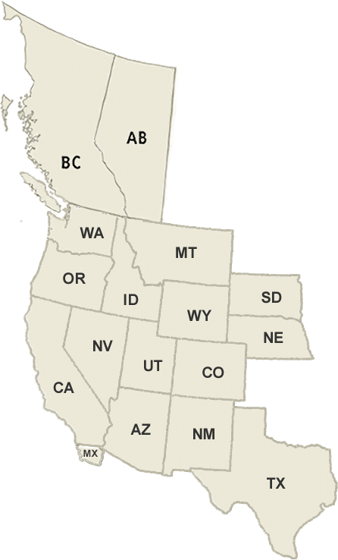
Who is WIRAB?
Statutory Authority: Established in 2005, as an independent body with statutory authority under Section 215(j) of the Federal Power Act to Advise FERC, NERC, and WECC on reliability matters in the Western Interconnection.
Membership: All state and provinces with load served in the Western Interconnection
Funding: Assessments approved by FERC to load serving entities under Section 215 of the Federal Power Act.

Slide 3
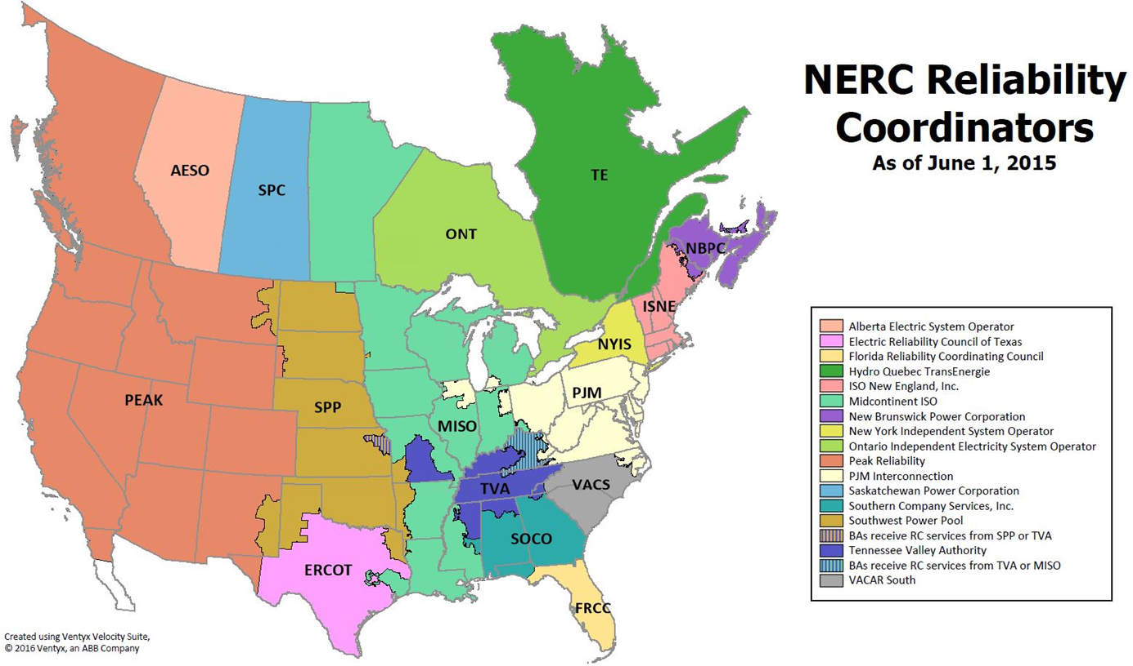
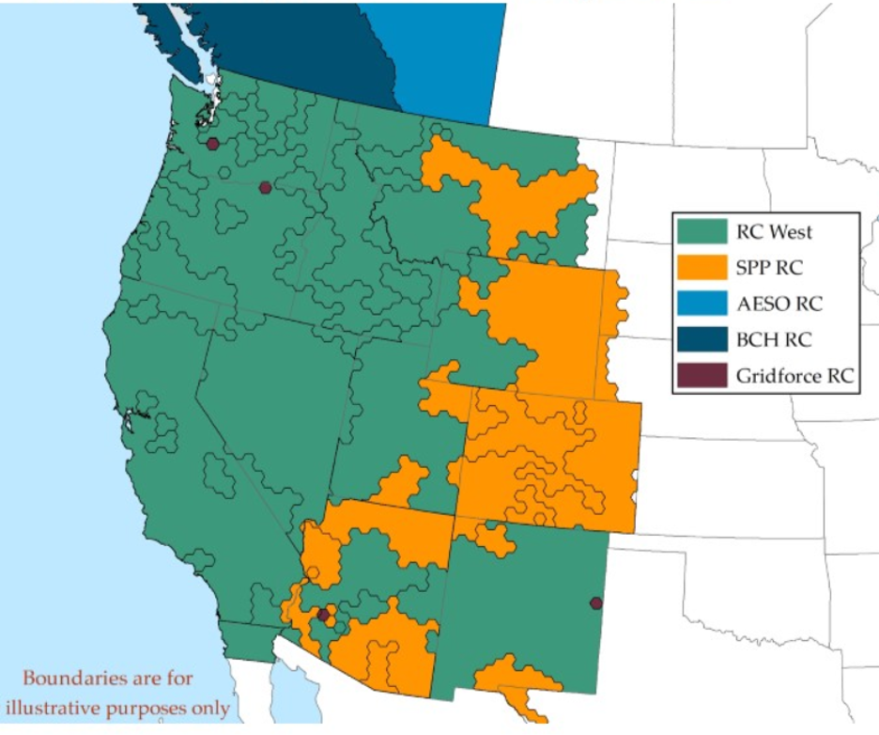
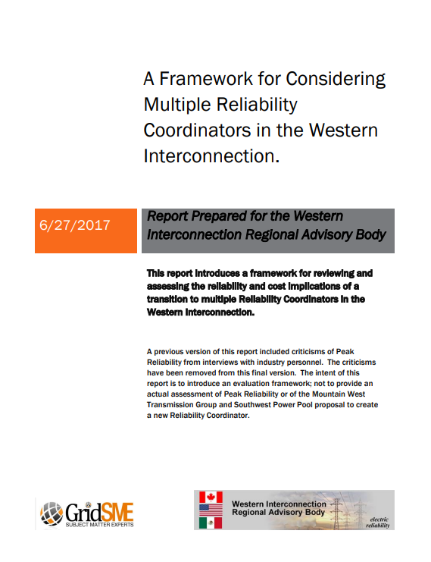
Western RC Transition (2019)
WIRAB Report
Beginning of 2019
End of 2019

Slide 4
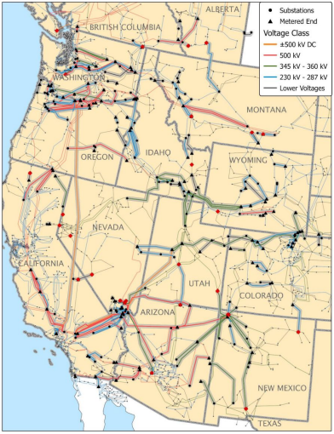
Western Interconnection Context
Large interconnected system
13 states, 2 Canadian Provinces + Baja
“WECC Donut”
Major load concentration in CA
Major generation sources:
PNW Hydro
RM Coal & Wind
DSW Nuclear & Solar
Empty space in the middle
PNW
RM
CA
DSW
Notes:
.

Slide 5
What is Loop Flow?
Definition: Unintended, unscheduled power flows that occur because electricity follows the path of least resistance (or impedance), not the commercial “contract path.”
Result: Actual MW flows spread across multiple parallel lines and cross Balancing Authorities and state boundaries, affecting facilities far from the scheduled transaction.

Slide 6
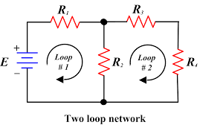
The Physics of Loop Flow (Unscheduled Flow)
Core Idea:
Power follows the easiest electrical path
Kirchhoff's Current Law (KCL)
At any junction (busbar or node) in the electrical grid, the total current flowing in must equal the total current flowing out.
Impedance and Ohm's Law
The path electricity takes is determined by the impedance (the total opposition to the flow of alternating current) of all available lines.
The Interconnected Nature of the Grid
Power generated in one location instantly affects the flow patterns across the entire system.
Notes:
The Physics of Loop Flow (Unscheduled Flow)
Loop flow is the phenomenon where electricity physically travels through unintended paths in the electrical grid, ignoring the direct contractual paths scheduled by operators. This behavior is governed by fundamental physical laws:
1. Kirchhoff's Current Law (KCL)
At any junction (busbar or node) in the electrical grid, the total current flowing in must equal the total current flowing out.
Implication: When a transmission line is overloaded or congested, the excess current cannot simply disappear; it must seek alternative routes through the interconnected grid to satisfy this law.
2. Impedance and Ohm's Law
The path electricity takes is determined by the impedance (the total opposition to the flow of alternating current) of all available lines.
The Rule: Electricity naturally disperses itself across all available parallel paths in inverse proportion to their impedance. Lower impedance paths carry more current.
Analogy: Think of water flowing down a river that splits into multiple channels. The widest, deepest (lowest resistance/impedance) channel carries the most water, but some water still flows down all other available channels.
Implication: If a direct transmission line has high impedance or is full, nearby lines with low impedance—even if they belong to a different utility or are in a "loop"—will automatically carry a portion of the flow.
3. The Interconnected Nature of the Grid
The Western Interconnection (WECC) is one vast, synchronous AC system. All interconnected generators and loads operate in unison.
The Result: Power generated in one location instantly affects the flow patterns across the entire system. Operators cannot physically force electricity to stay within specific administrative boundaries or contractual lines; they can only manage the overall system balance and line capacities.
In summary, loop flow is a direct consequence of electricity obeying physics (following the path of least resistance) rather than human-made contract paths or market boundaries.

Slide 7
Scheduled vs. Unscheduled (Loop) Flow
Schedule from PNW to CA (i.e. Sell Energy from PNW to CA)
Unscheduled Flow
Scheduled
Flow
PNW
RM
Contract Path
Unscheduled Flow
CA
DSW
Unscheduled Flow

Slide 8
Scheduled vs. Unscheduled (Loop) Flow
Schedule from PNW to CA but through RM and DSW because transmission was available and/or cheaper
Scheduled Flow
PNW
RM
Unscheduled
Flow
Contract Path
Scheduled Flow
CA
DSW
Scheduled Flow

Slide 9
Unscheduled Flow Creates Congestion
Congestion on Path from PNW to CA due to Unscheduled Flows
Scheduled Flow
PNW
RM
Unscheduled
Flow
Congested Path
Scheduled Flow
CA
DSW
Scheduled Flow

Slide 10
Western Interconnection Unscheduled Flow Mitigation Plan (WIUFMP)
UFMP is a FERC Approved congestion management plan for select Qualified Paths in the Western Interconnection
Accomplished by:
Use of Qualified Controllable Device(s) (QCD)
Phase Shifting Transformers
Curtailment of transmission schedules
Applies to all organizations that generate power, serve load, and/or buy, sell, or transport energy in the West
Requires after-the-fact accounting performed by the Plan Administrator (SPP)

Slide 11
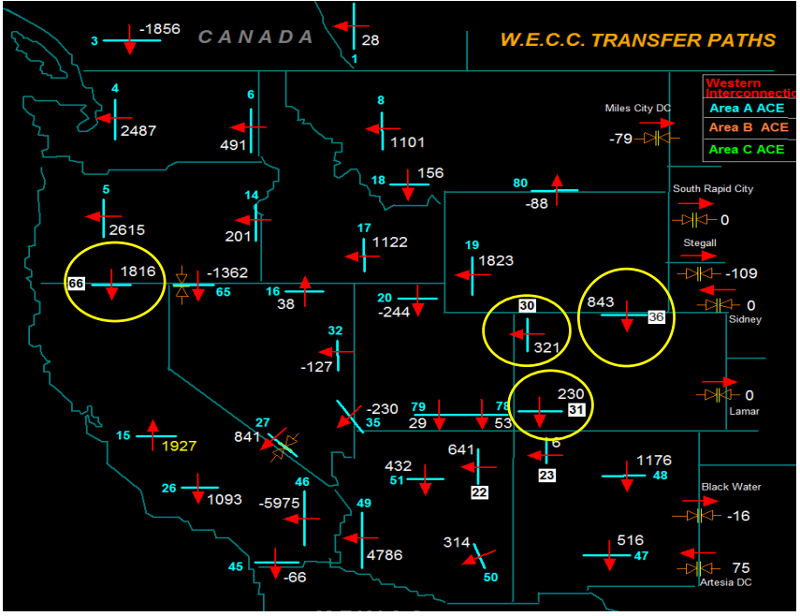
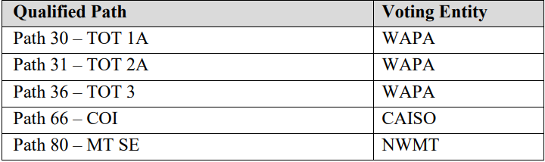
UFMP Qualified Paths
Qualified Path (QP):
A transmission element, or group of transmission elements, where actual flows have exceeded 97% of the applicable Facility Rating for at least 100 hours in past 36 months
Five Qualified Paths
PNW
RM
CA
DSW

Slide 12
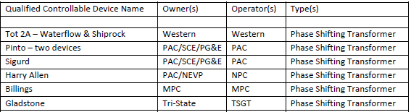
Phase Shifting Transformers
Control power flow over parallel lines by adjusting phase angle at one end of line
For example: Adjusting Phase angles in RM Region can divert power away from Path 66 (COI)
PNW
RM
CA
DSW
= Approx. location of Qualified Phase Shifting Transformers

Slide 13
Phase Shifters Relieve Unscheduled Flow
Congestion on Path from PNW to CA due to Unscheduled Flows
Scheduled Flow
PNW
RM
Unscheduled
Flow
Congested Path
Scheduled Flow
CA
DSW
Scheduled Flow
= Phase Shifter

Slide 14
Phase Shifters Relieve Unscheduled Flow
Congestion relieved on Path from PNW to CA due by coordinating the operation of phase shifters
Did not have to redispatch generation!
Scheduled Flow
PNW
RM
Unscheduled
Flow
Congestion Relieved
Scheduled Flow
CA
DSW
Phase Shifter Owners coordinate the operation of Phase Shifters to alleviate congestion on Congested Path
Scheduled Flow
= Phase Shifter

Slide 15
Schedule Cuts Relieve Unscheduled Flow and Congestion
Congestion relieved on Path from PNW to CA due to cutting schedules which redispatches generation
Costs Generators & Customers Money
Sender Reduces Export Schedule
Decrease Generation
Scheduled Flow
PNW
RM
Unscheduled
Flow
Congestion Relieved
Scheduled Flow
CA
DSW
Increase Generation
Scheduled Flow
Receiver Reduces Import Schedule

Slide 16
Process and Limitations of the WIUFMP
Process:
Advise the Reliability Coordinator (RC)
On-path actions by the path owner/operator
Coordinated operation of Qualified Controllable Devices (QCDs), i.e. phase-shifting transformers (PSTs)
If needed, curtail contributing schedules (hourly events)
Limitations:
Narrow Scope (only “Qualified Paths”)
High Trigger threshold
Tag-centric Relief
Limited “alternative actions”
Phase shifters (QCDs) dependent
Seams & Market Mismatch
Transparency/modeling
Plan administrator (SPP) allocates costs
Notes:
Scope (Path-limited)
Applies to a few Qualified Paths, not all SOLs/IROLs
Triggers & Timing
Relief typically after ≥95% loading; hourly cadence; :25 request deadline
Tag-centric Relief
Curtailment by tag “buckets” (priority/TDF) — blunt vs. impact-based
Limited capture of Dynamic Transfers and native/network load
Device Dependence
Relief hinges on a small fleet of PSTs (outages, wear, reversal effects)
Alternative Actions
Hard to credit redispatch/alternate transactions in-hour; manual verification
Seams & Market Mismatch
Multiple RC/BA/market processes; path-based ATC ≠ physical flows
Misaligned with DA/RT market cadence and interface pricing
Transparency/Modeling
No single, shared impact view; path tags mask true contributors

Slide 17
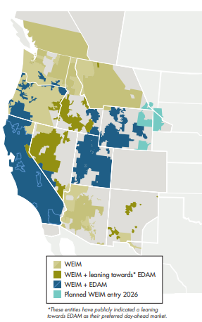
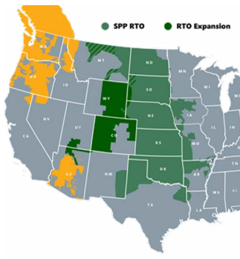

Market Seams
Notes:
if they heard in real time for markets expand in the West seems to introduce new pressure points path based practices don't always reflect actual power flows syndicated through this discussion of loop flow pricing and scheduling across interfaces can be tricky and coordination kits harder when multiple tariffs balcony balancing authorities and market operators are in play the result is more places where unscheduled flow can matter and more complex city can add more complexity in who acts and then who also pays

Slide 18
Challenges from Loop Flow at New Market Seams
More unscheduled (loop) flows between markets → congestion, reliability stress, and cost shifts
Legacy UFMP limits insufficient for today’s seams
Path-based practices ≠ physical flows
Adopt a single, West-wide, RC-led congestion process using the Enhanced Curtailment Calculator
Notes:
The physics won’t change — loop flow appears where markets split. Today’s tools (WIUFMP; path-based ATC) are too narrow or coarse for multi-market day-ahead/real-time operations, and seams complicate pricing, coordination, and shared programs.
Why an ECC-Centered Approach Addresses This
Impact-based relief (all contributors: e-Tags, DTs, GTL) with pro-rata obligations
Intra-hour recalcs; covers SOLs/IROLs; keeps UFMP/PST but expands scope
RC-led, single view with shared model & audit trail; aligns with market-to-market / market-to-non-market coordination
Clear obligations → fewer disputes; more transfer capability unlocked

Slide 19
Wrap up
Loop flow is inherent in interconnected AC networks (especially pronounced in the Western Interconnection)
Today the West uses WIUFMP to provide a structured, region-wide response for major Paths
With increased market seams, coordination may be more difficult and new risks will develop, therefore congestion management in the West should be improved.

Slide 20
Thank You!
Eric Baran
ebaran@westernenergyboard.org

Slide 21
WIRAB Official Membership
Alberta
Arizona
British Columbia
California
Colorado
Betsy Li Alward, Director, Generation, Transmission and Markets Policy, Energy Policy, Alberta Energy
Lea Marquez Peterson, Commissioner, Arizona Corporation Commission*
Chris Gilmore, Executive Director, Electricity Policy Branch, Ministry of Energy, Mines and Low Carbon Innovation
Siva Gunda, Vice Chair, California Energy Commission**
James Lester, Senior Policy Lead on Transmission, Climate and Energy, Colorado Energy Office
Idaho
Cally Younger, Administrator, Idaho Governor’s Office of Energy and Mineral Resources
Mexico
Vacant
Montana
Sonja Nowakowski, Director of the Montana Department of Environmental Qulity
Nebraska
Tim Texel, Executive Director, Nebraska Power Review Board
Nevada
Dwayne McClinton, Director, Nevada Governor's Office of Energy
New Mexico
Vacant
Oregon
Janine Benner, Director, Oregon Department of Energy
South Dakota
Greg Rislov, Commission Advisor, South Dakota Public Utility Commission
Texas
Vacant
Utah
Emy Lesofski, Director, Utah Governor's Office of Energy Development
Washington
Elizabeth Osborne, Senior Energy Policy Analyst, Washington State Energy Office
Wyoming
Chris Petrie, Commissioner, Wyoming Public Service Commission
21
*WIRAB Chair; **WIRAB Vice-Chair

Slide 22
UFMP Administrator – Southwest Power Pool
Qualified Controllable Device owners and Transmission Operators of Qualified Paths select Plan Administrator
Southwest Power Pool’s responsibilities:
Collects cost information from Qualified Controllable Device (QCD) Owners
Confirms cost information
Determines QCD cost recovery rate
Allocates QCD Rate to Applicable Entities (i.e. proportionate percentage to Load, Generation, Imports, Exports)
Tacks on administrative costs
Administers invoices
Develops Administrative Report (2016 Report from WECC)
Resolves Disputes regarding UFMP

Slide 23
UFMP, Reliability Coordination and the UFMP Administrator
Transmission Operators (TOPs):
Monitor Qualified Paths
Advise RC of potential situations
Attempt to alleviate the issue on their own
Requests coordinated operation of QCD
Requests curtailment of schedules
Reliability Coordinator(s):
Monitors situations
Reviews requests for curtailment of schedules for reliability implications
Coordinates with neighboring RCs
Either approves or denies the request
UFMP Administrator:
Collects and allocates costs associated with UFMP
Administers invoices and collects payment

Slide 24
Annual COPS Hours and Cost

