Slide 1
NAESB
WEQ-012
PKI Overview
March 19, 2019

Slide 2
North American Energy Standards Board OpenFMB PKI Presentation
Background & Introduction
Notes:
2

Slide 3
History of WEQ PKI Standards
2006: NAESB WEQ-012 Public Key Infrastructure Business Practice Standards Developed – NAESB WEQ Version 001
2008: FERC Adopts NAESB WEQ Version 001 Business Practice Standards
However, a process for the authorization for certificate authorities was required for implementation
2011: NAESB Board of Directors approves the Authorized Certification Authority (ACA) Process
2014: FERC Adopts NAESB WEQ Version 003 Business Practice Standards
2014: FERC Adopts NAESB WEQ Version 003 Business Practice Standards
2016: FERC NOPR NAESB WEQ Version 003.1 Business Practice Standards

Slide 4
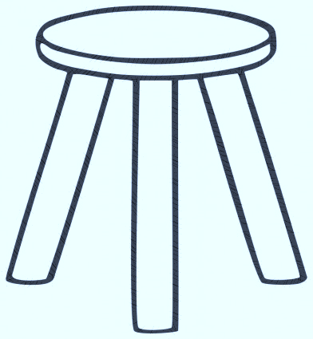
NAESB PKI Program
Standards
WEQ-012 Public Key Infrastructure
Specifications
NAESB Accreditation Requirements for ACAs
Process
NAESB Board Certification Committee ACA Process
TRUST

Slide 5
A Standard for Verifiable Trust
Three pillars to ensure trust
ACA Certification Process
A recurring NAESB process to ensure that Certificate Authorities are qualified to issue NAESB Digital Certificates
ACA Accreditation / Obligation Specifications
A detailed document describing requirements of a Certificate Authority in order to issue NAESB digital certificates. Reviewed annually at minimum – changes as needed to address vulnerabilities
WEQ-012 Standard: End Entity Obligations
FERC regulated entities must comply with the standards contained in WEQ-012, as specified within each NAESB standard that employs WEQ-012. Reviewed annually at minimum – changes as needed to address vulnerabilities

Slide 6
Trust is a Continuum
Is not binary – have/do not have trust
Ranges from no trustworthiness to high trustworthiness
NAESB’s PKI Program contains a series of documents that establish a trust framework for other NAESB standards to adopt
Each NAESB standard specifies the level of trust required to establish trust for End Entity identification.

Slide 7
Foundational Trust Model
The WEQ-012 standard is designed for use by any/all NAESB standards that require PKI functionality, i.e. OASIS
WEQ-012 is flexible, defines lowest to highest trust levels allowable in NAESB standards
No trust, i.e. self-signed certs are prohibited
NAESB standards that adopt WEQ-012 must specify the required Assurance Level, along with any other X.509 certificate fields that are required for that standard i.e. Common Name specifications

Slide 8
Demands of WEQ-012
WEQ-012 demands very little from any NAESB standard that wishes to adopt PKI
Specify the requirements for Name fields in a digital Certificate, i.e. Subject Common Name (CN)
O and OU fields MUST match EIR registration
The required assurance level
Additional X.509 field usage requirements, i.e. subject alternative name, key usage, etc.

Slide 9
Assurance Levels
What is an assurance level
Four Levels: Rudimentary, Basic, Medium, High
Each level indicates the depth of investigation into a parties identity before issuing a certificate
Why do we need assurance levels
Common frame of reference using standard identifiers owned by NAESB
Some applications require certain level of assurance, i.e. OASIS requires Basic level
Each NAESB standard that adopts WEQ-012 MUST specify it’s required assurance level

Slide 10
Assurance Level Descriptions
Assurance Level | Description
Rudimentary | This level provides the lowest degree of assurance concerning the identity of the end entity. One of the primary functions of this level is to provide data integrity to the information being signed. This level is relevant to environments in which the risk of malicious activity is considered to be low.
Basic | This level provides a basic level of assurance relevant to environment where there are risks and consequences of data compromise, but they are not considered to be of major significance. This may include access to private information where the likelihood of malicious access is not high.
Medium | This level is relevant to environments where risks and consequences of data compromise are moderate. This may include transactions having substantial monetary value or risk of fraud, or involving access to private information where the likelihood of malicious access is substantial.
High | This level is reserved for those environments where the threats to data are high, or the consequences of the failure of security services are high. This may include very high value transactions or high levels of fraud risk.

Slide 11
Identification Requirements
Requests for Subscriber Certificates in the name of an affiliated organization shall include the organization name, address, and documentation of the existence of the organization in the EIR, applicable to all NAESB standards
The Authorized Certification Authority or RA shall verify the information, in addition to the authenticity of the requesting representative and the representative’s authorization to act in the name of the organization.
The higher the assurance level the more stringent the “investigation”

Slide 12
Identity proofing requirements
Assurance Level | Identification Requirements (in person)
Rudimentary/Level 1 | The name associated with the subscriber is provided by the applicant and accepted without verification
Basic/Level 2 | Possession of a valid current primary Government Picture ID that contains applicant’s picture, and either address of record or nationality (e.g. driver’s license or passport)
Medium/Level 3 | Possession of verified current primary Government Picture ID that contains applicant’s picture and either address of record or nationality (e.g. driver’s license or passport)
High/Level 4 | Verification of two independent ID documents or accounts, meeting the requirements of Level 3 (in-person and remote), one of which must be current primary Government Picture ID that contains applicant’s picture, and either address of record or nationality (e.g. driver’s license or passport), and a new recording of a biometric of the applicant at the time of application
NOTE: Committee leveraged best practices of established commercial practices such as CA/B Forum
Baseline requirements, NIST guidelines, and industry specific requirements for these levels.

Slide 13
NISTIR 7628 REV 1compliant
3.13 IDENTIFICATION AND AUTHENTICATION (SG.IA)
Identification and authentication is the process of verifying the identity of a user, process, or device,
as a prerequisite for granting access to resources in a smart grid information system.
NISTR Reference | NAESB PKI Reference
SG.IA-1 Identification and Authentication Policy and Procedures | NAESB Accreditation Requirements for Authorized Certification Authorities WEQ-012 Standard 012-1.3.3 End Entities WEQ-012 Standard 012-1.4.3 End Entity Obligations
SG.IA-4 User Identification and Authentication | WEQ-012 Standard 012-1.9 INITIAL REGISTRATION
SG.IA-5 Device Identification and Authentication | WEQ-012 Standard 012-1.9 INITIAL REGISTRATION

Slide 14
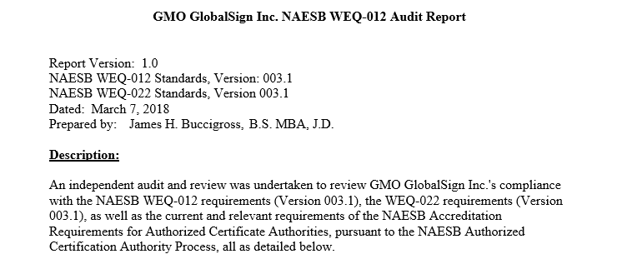
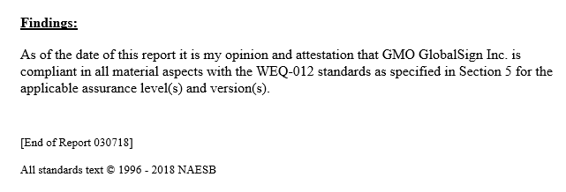
ACA Audit Requirement

Slide 15
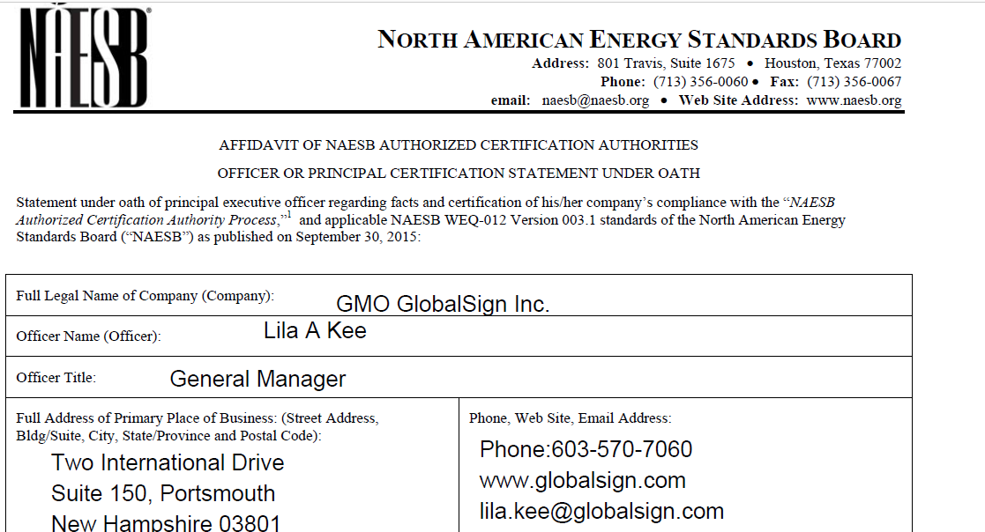
Certification Process

Slide 16
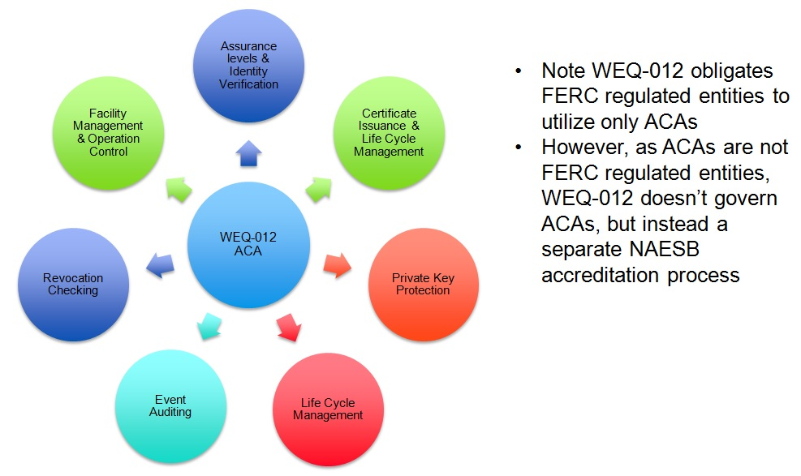
WEQ-012 ACA Responsibilities

Slide 17
Roles and Responsibilities
Registration Authority
Responsible for validating the identity of a party seeking a digital certificate. Typically performed by an ACA or Local Registration Authority (LRA)
Certificate Subscriber
Employs a digital certificate for identification purposes (i.e. access to EIR, OASIS server ID)
Certificate Authority
Issues digital certificates to parties based on registration authority approval

Slide 18
Where to find ACA’s
List of Authorized Certificate Authorities on NAESB’s website
As of February 2019, there were four:
OATI
Systrends
GlobalSign
SSL.com

Slide 19
Key Sizes and Life Expectancy
All Certificate Authority Certificates that expire after 12/31/2012, when they are replaced should be signed with keys of at least 4096 bits for RSA or DSA and at least 256 bits for ECDSA
Subscriber Certificates issued after the effective date of these requirements (2/18/2014), shall contain public keys that are at least 2048 bits for RSA, DSA, or Diffie-Hellman, or 224 bits for elliptic curve algorithms.
Limits an ACA “issuing key” to 4 years for certificate issuance and 6 years for CRL signing
ACA Root certificate lifetime limited to 20 years
Subscriber certificates still limited to two years max lifetime

Slide 20
North American Energy Standards Board OpenFMB PKI Presentation
Questions ??
Notes:
20

Slide 21
Reference Materials
Rudimentary | Current version of NIST SP 800-63A Digital Identity Guidelines: Enrollment and Identity Proofing, Section 4.3 “Identity Assurance Level 1”
Basic | Current version of CA/Browser Forum Baseline Requirements for the Issuance and Management of Publicly-Trusted Certificates (CABF BRs) Section 3.2.3 Authentication of Individual Identity.
Medium | Current version of CA-Browser Forum’s Guidelines For The Issuance And Management Of Extended Validation Certificates, Chapter 11.2.2 “ Acceptable Method of Verification (4) Principal Individual
High | Current version of NIST SP 800-63A Digital Identity Guidelines: Enrollment and Identity Proofing, Section 4.5 “Identity Assurance Level 3”

